Slide 1
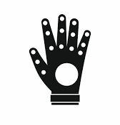
Smart Glove Project
Submitted TO: Submitted BY:
Mr. MAHESH mANCHANDA Sanjay singh
aYUSH dhanai

Slide 2

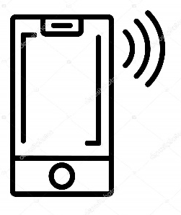
Idea Description
Our idea is to help mute people communicate better with the help of technology. We plan to build a special glove which when worn by a mute person, will automatically read their sign language and convert it into speech in real time, so that a normal person will be able to understand them better.

Slide 3
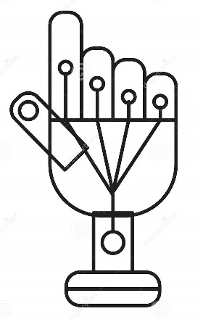
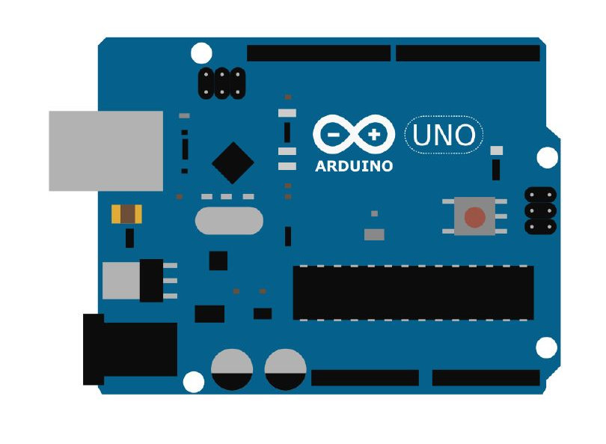
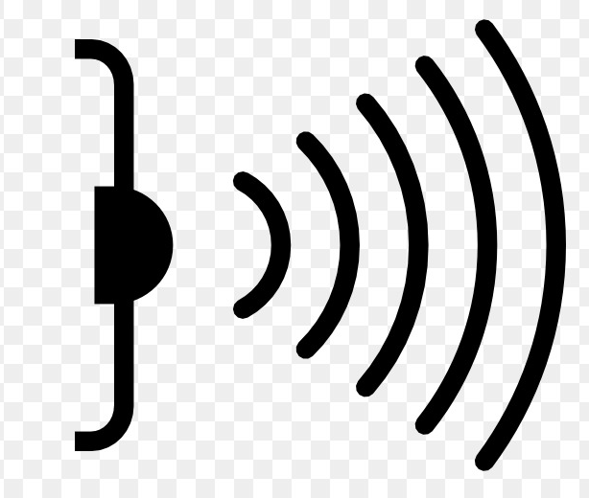
Workflow DESCRIPTION
We plan to use arduino and sensors to read data from glove and transfer it to users mobile phone to decode it and convert it into English.

Slide 4
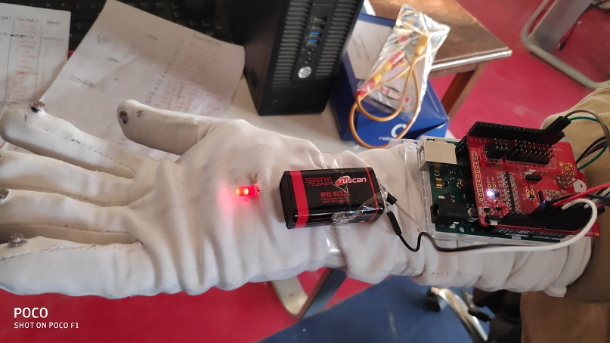
Arduino powered Glove
ARDUINO
GLOVE
SENSORS
BLUETOOTH
MODULE
BATTERY

Slide 5

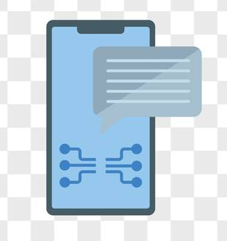
Working
Smart glove can convert sign language of mute people into english speech so that they can communicate better.
Glove is equipped with sensor which sense the movements of hands and transfer the data to user’s phone via bluetooth.
HAND GESTURES
(DATA)
PROCESS & CONVERT
DATA
OUPUT DATA

Slide 6
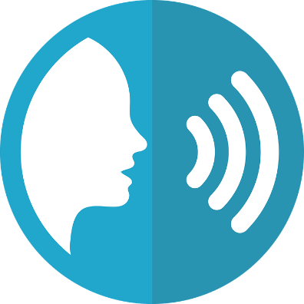
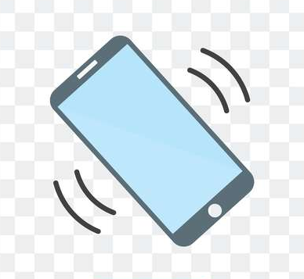
wORKING
Once data is received in phone, it is then decoded via an app and is shown in plain text English.
English text is then converted into speech on the fly.

Slide 7
Android app
App will have two modes :
1. Deaf Mode : When used by a deaf person, he will be able to read what other person is saying in his mobile screen.
2. Mute Mode : When used by a mute person, he will be able to use gestures to communicate with the other person.

Slide 8
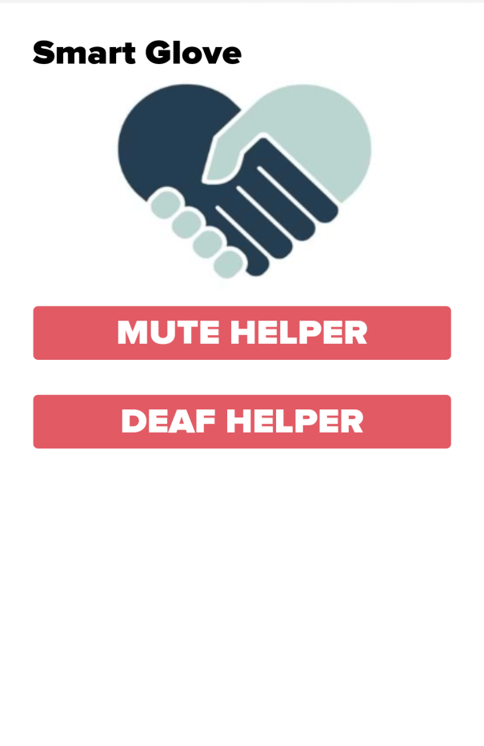
Mute mode & Deaf Mode

Slide 9
Deaf Mode
In deaf mode, user will be able to use the app’s inbuilt speech recognizer.
Speech will be converted into text on the fly on users screen even without internet connection.
This will enable deaf people to read what the other person is saying in realtime.

Slide 10
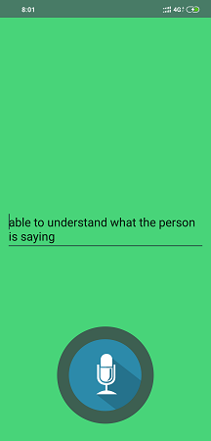
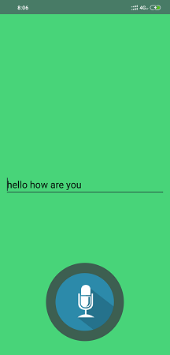
Deaf Mode :

Slide 11
THANK YOU
Project By
SANJAY SINGH
AYUSH DHANAI

